Slide 1
APPLIED PHYSICS
(SEAP-113)

Slide 2
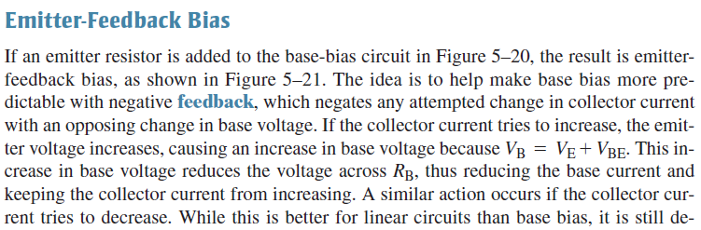
Emitter Feedback Bias Configuration

Slide 3
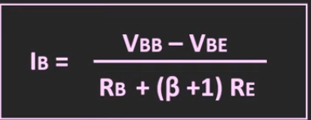
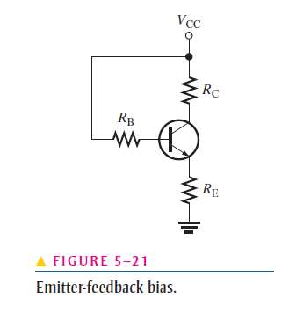

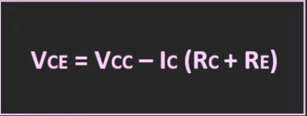

Emitter Feedback Bias Configuration
In previous configuration, the Q point was not stable on the load line so the goal is to make it stable. The solution is Emitter Bias Configuration

Slide 4

Some formulas
$I_{C}$ = $α$ $I_{E}$
$\frac{I_{C}}{I_{E}}= α$ (Alpha)
$α=\frac{β}{1+β}$
$β=\frac{ I_{C}}{I_{B}}$
Value of alpha is nearly equal to 1
$I_{C}$ ≈ $I_{E}$

Slide 5

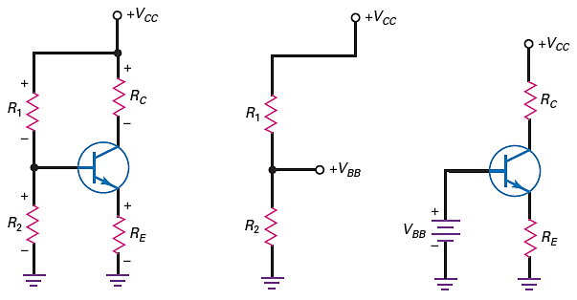
Voltage Divider Bias Configuration
It is most widely used configuration
At base a voltage divider network, hence called voltage divider bias

Slide 6
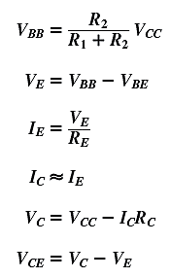
Voltage Divider Bias Configuration (contd.)
Analysis for the Q point can be as follows

Slide 7
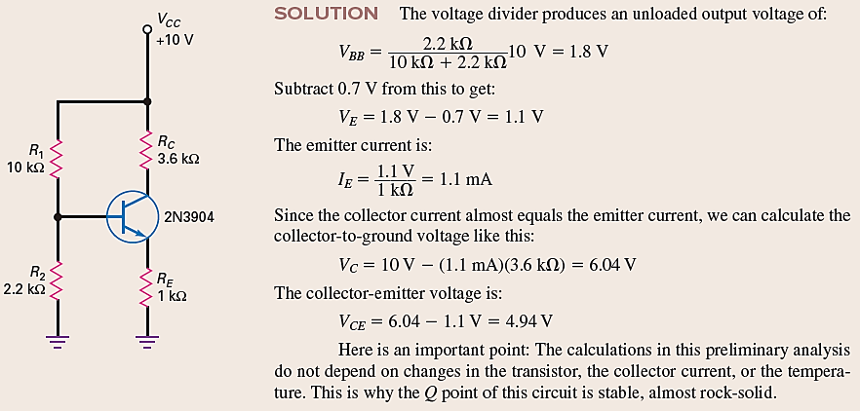
Voltage Divider Bias Configuration (contd.)
Find the Q point for the circuit given

Slide 8
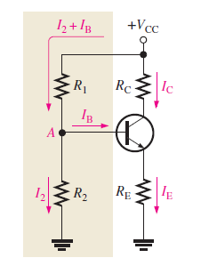
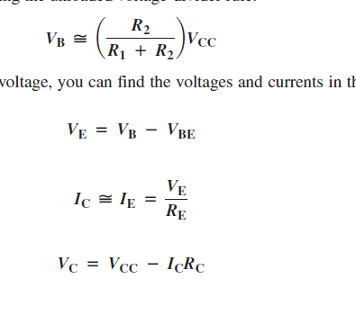
Voltage Divider Biased

Slide 9
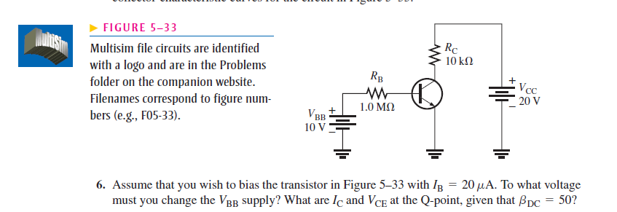
Some Numericals

Slide 10
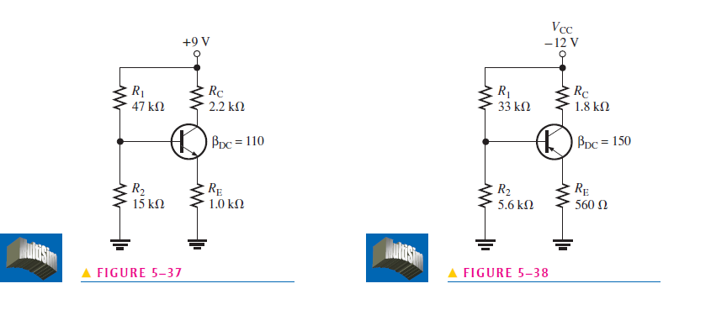
Contd.

Slide 11
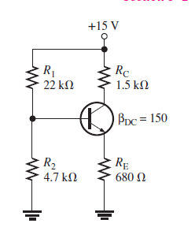
Numerical
Find the Q-point.

Slide 12
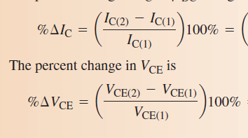
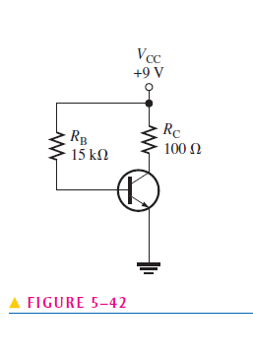
Numerical
Find the Q-point.
Beta =20
If beta changes then new Q-point will be?
Percentage Change in Q-point?

Slide 13
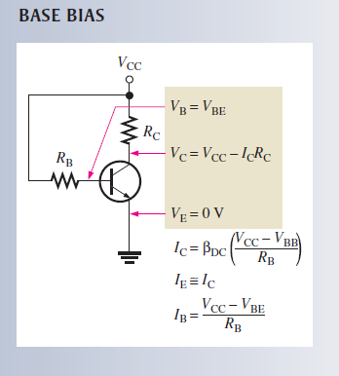
Base Bias – Formula + Circuit Diagram

Slide 14
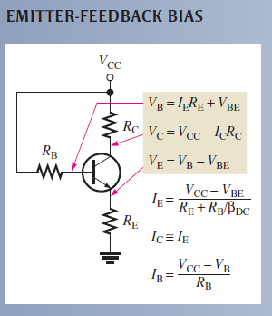
Base Bias – Formula + Circuit Diagram

Slide 15
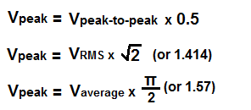
Formulas for conversion

Slide 16

Half Wave Rectifier (contd.)
Average value of half wave output voltage can be calculated as:
$$V_{Avg}=\frac{{2V}_{P}}{π}$$
Equation shows that V_{avg} is approx. 31.8% of V_{p} (Ideal Diode Case)
When a practical model is used peak output voltage can be calculated as:
$$V_{P(out)}=V_{P(in)}−0.7V$$

Slide 17

Full Wave Rectifier (contd.)
The average value of full wave rectifier can be calculated as:
$$V_{Avg}=\frac{{2V}_{P}}{π}$$
Equation shows that V_{avg} is approx. 63.6% of V_{p} (Ideal Diode Case)
The frequency of full wave rectifier will be equal to
$$f_{out}=2f_{in}$$

Slide 18

Full Wave Rectifier (contd.)
the bridge output voltage in case of ideal approx. can be calculated as:
$$V_{P(out)}= V_{P(sec)}$$
By using the second approx. the bridge output voltage can be calculated as:
$$V_{P(out)}=V_{P(sec)}−1.4V$$

Slide 19
Full Wave Rectifier (contd.)
the bridge output voltage in case of ideal approx. can be calculated as:
$$V_{P(out)}= V_{P(sec)}$$
By using the second approx. the bridge output voltage can be calculated as:
$$V_{P(out)}=V_{P(sec)}−1.4V$$

Slide 20
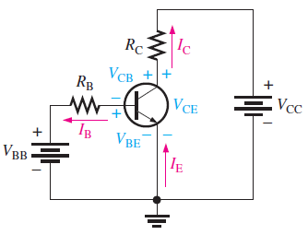

BJT Circuit Analysis (contd.)
By using Kirchof’s voltage law
$$V_{RB}=V_{BB}−V_{BE}$$
By Ohm’s Law
$$V_{RB}=I_{B}R_{B}$$
By substituting the values
$$I_{B}=\frac{V_{BB}−V_{BE}}{R_{B}}$$

Slide 21

BJT Circuit Analysis (contd.)
The voltage at collector can be calculated as:
$$V_{CE}=V_{CC}−V_{RC}$$
Drop across the collector resistor is
$$V_{RC}=I_{C}R_{C}$$
By substituting the values
$$V_{CE}=V_{CC}−I_{C}R_{C}$$
Where
$$I_{C}=β_{DC}I_{B}$$

